Slide 1
Finlatics : Banking Project
Analysis of insights gained.
Deepansh Agnihotri ; 17/06/2024

Slide 2


Slide 3


Slide 4


Slide 5
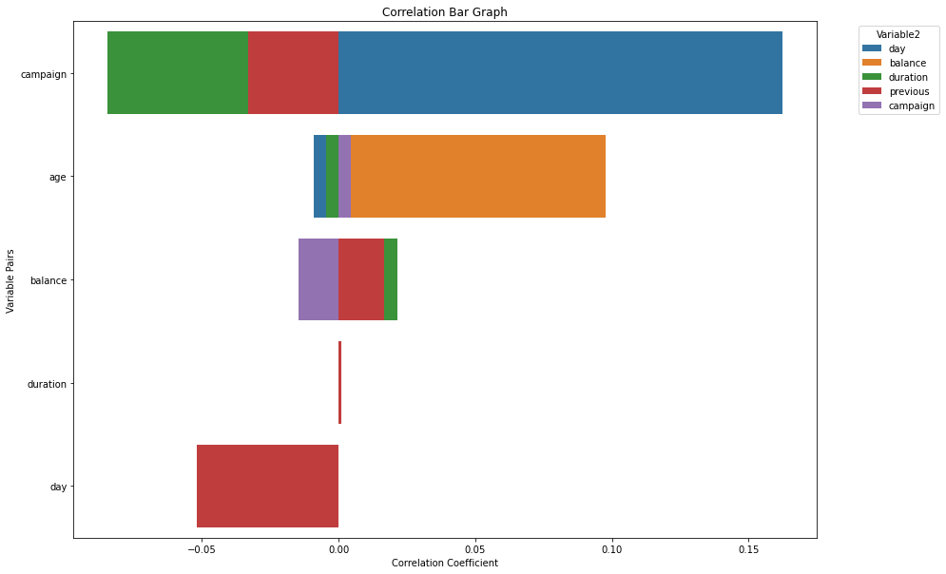

Slide 6
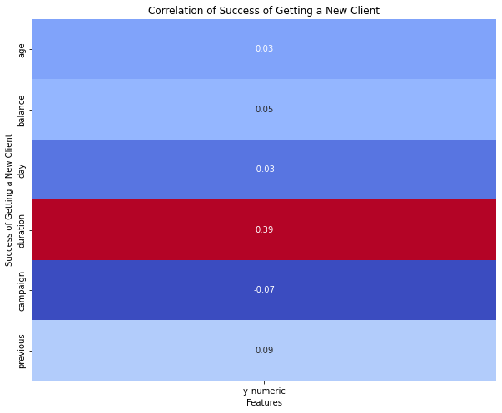

Slide 7
